Slide 1

CHAT-BOTS
Using Microsoft Bot Framework and
Azure Cognitive Services
Rachhek Shrestha

Slide 2
What a BOT is Not ?

Slide 3
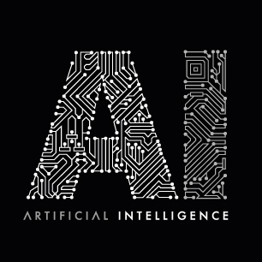
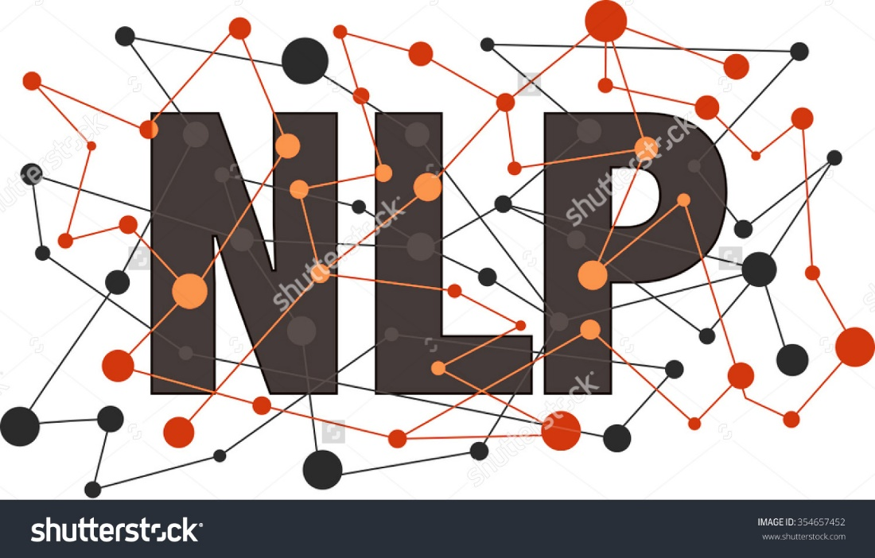
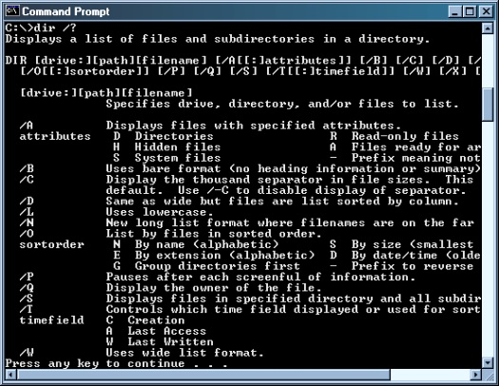
What a BOT is Not ?
Just text
interface
Bots ≠ AI
Just NLP

Slide 4
What Is A BOT?

Slide 5
Simply, a bot is an application that performs an automated task.
Nothing else.

Slide 6
BOTS
CHAT BOTS
AI BOTS
Making a reservation
Adding event to calendar
Displaying Info
Buy stuff online
Engages with People
Stimulates Conversation
Eg. Messenger bot
Has a ‘learning’ ability
Evolve over time
Gather ‘intelligence’ over time
Eg. Siri, Google Now, Cortana

Slide 7
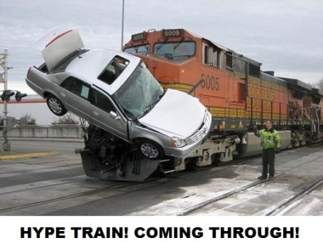
Why the Hype on Bots?

Slide 8



Mobile
Apps
Websites
Bots

Slide 9
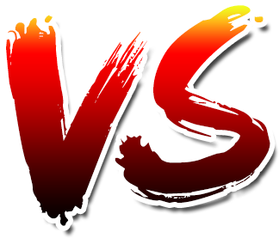
Apps
BOTS

Slide 10
Apps
BOTS
How are bots different than apps?
What can bots do that apps cannot already?
Are apps and bots vastly different from each other?
In which ways are they similar?
Are bots the new apps?
Are bots just a temporary hype?
Can bots replace mobile apps?

Slide 11
BOTS
Easier to install than apps
Lots of use cases that don’t justify a mobile app.
Messaging apps are ubiquitous
They have highest amount of user engagement
Easily bi-directional
Complexity is moved to the cloud
Portable
Humans are hardwired for language and conversation

Slide 12
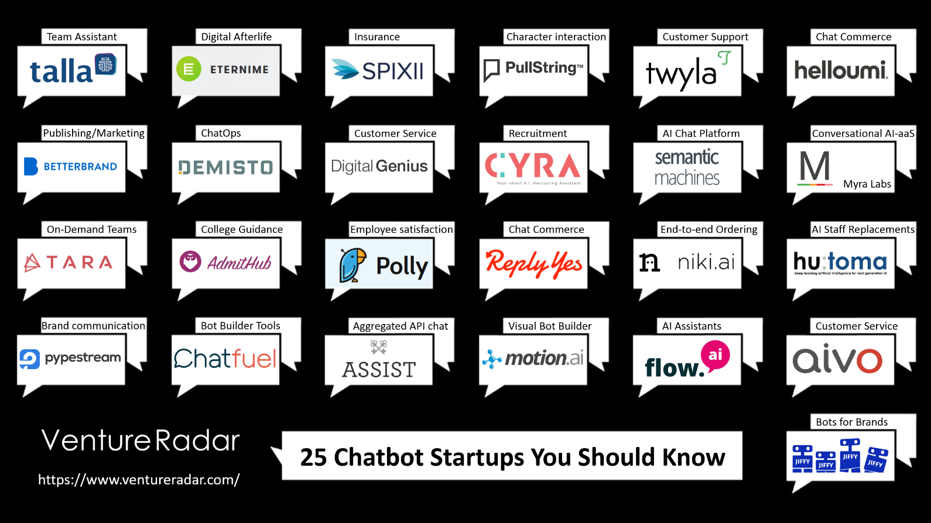

Slide 13
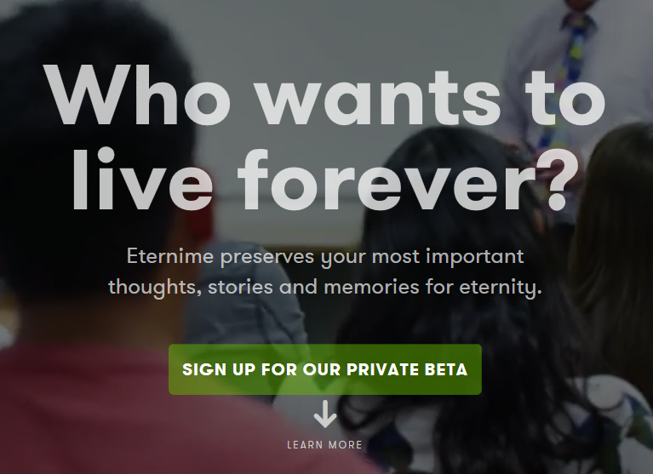
Eterni.me
Sign up
Let the platform learn your speech pattern and life stories
Converse with loved ones after death

Slide 14
DigitalGenius.com
Human+AI Customer Service

Slide 15
DEMISTO
Company specializing on security ChatOps platform

Slide 16
Rightclick.io
Create your website by telling your preference to a bot

Slide 17
Microsoft Bot Framework

Slide 18
Microsoft Bot Framework
Framework to Build, Publish and Manage your Bots.
For Developers:
Reach a broad set of users that are already chatting
More capable of supporting services (Azure cognitive, translation, history)
Build your own bots with Bot Builder SDK
For Businesses:
Reduced cost of development
Higher quality bots

Slide 19
Components OF Microsoft Bot Framework

Slide 20



Bot Framework Developer Portal
Bot Builder SDK
Bot Directory

Slide 21
BOT builder Sdk
Node.js, .NET and REST
Dialogs
Built-in prompts
Yes/No, string, Number choices
FormFlow
Rich Interaction
Add attachments(image, video etc.)
Services extension for Language Understanding (LUIS)
Online/Offline Chat Emulator

Slide 22
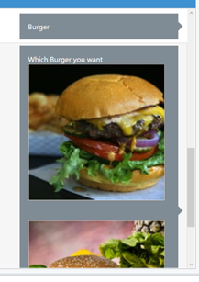
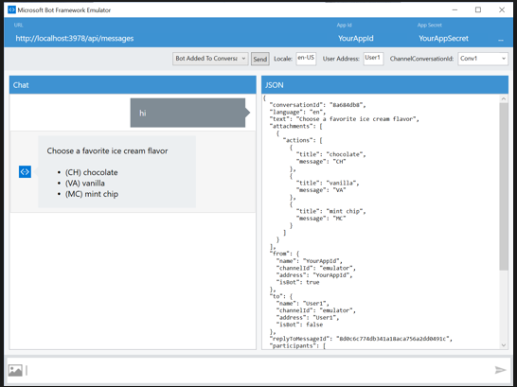
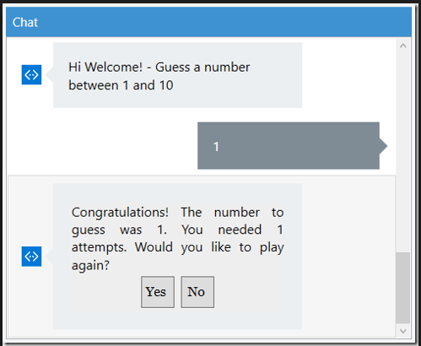
Prompts
Attachments
Emulator

Slide 23
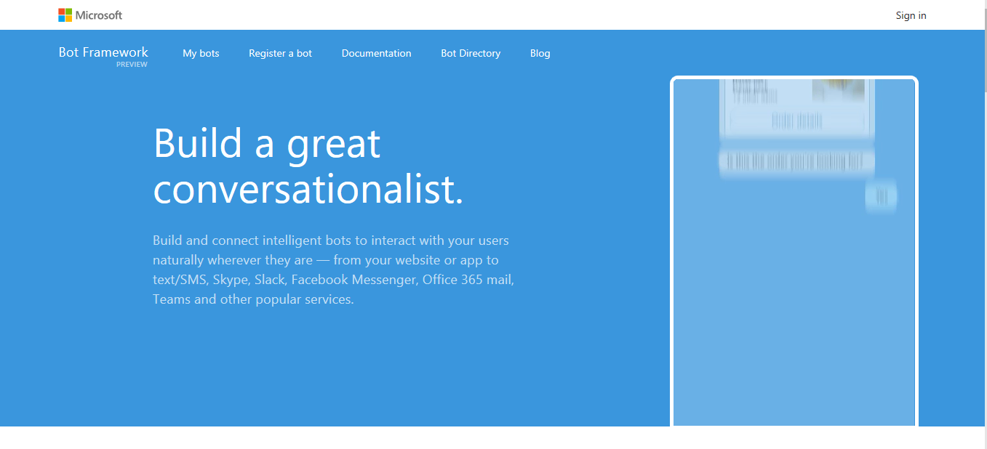
BOT Developer Portal
Dev.botframework.com
Register your Bot
Connect to channels
Test
Publish
Manage
Measure

Slide 24
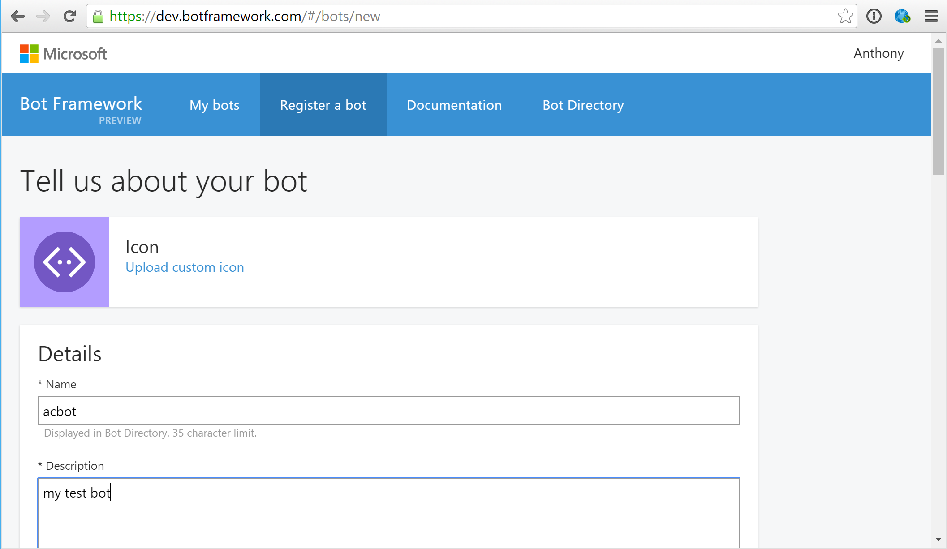
Bot Registration

Slide 25
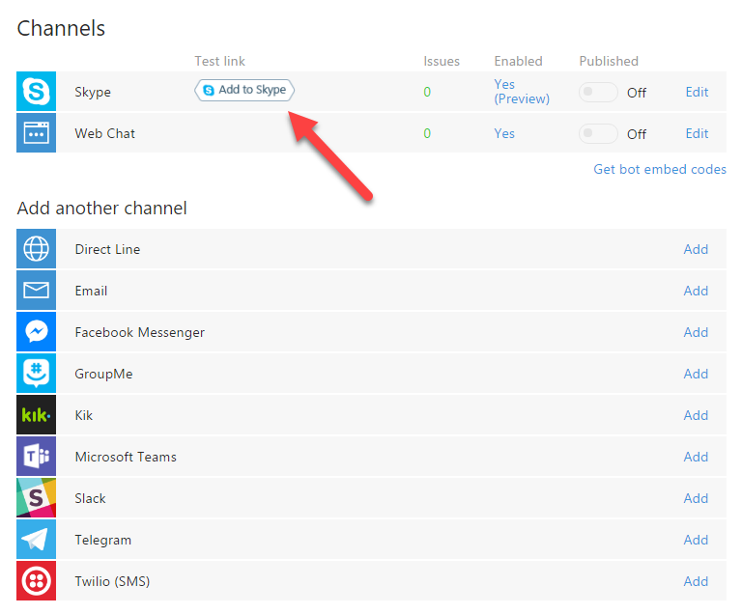
Channels

Slide 26
Publish
Publish from the dashboard
Best practices
Provide as much as value to users within the channel
Participate in a productive conversation
Craft an engaging welcome message
Emotion and personality to bot is important
Give feedback
Keep the user in control
Should meet minimum guidelines as provided by the Microsoft
Submitted bots will be reviewed before it gets published.

Slide 27
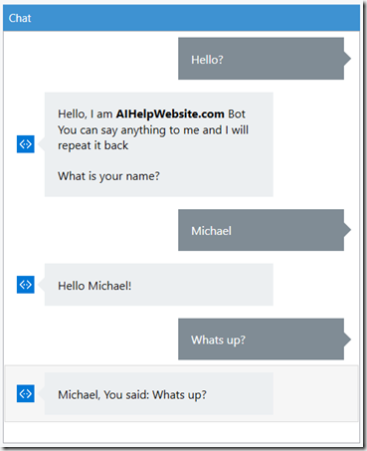
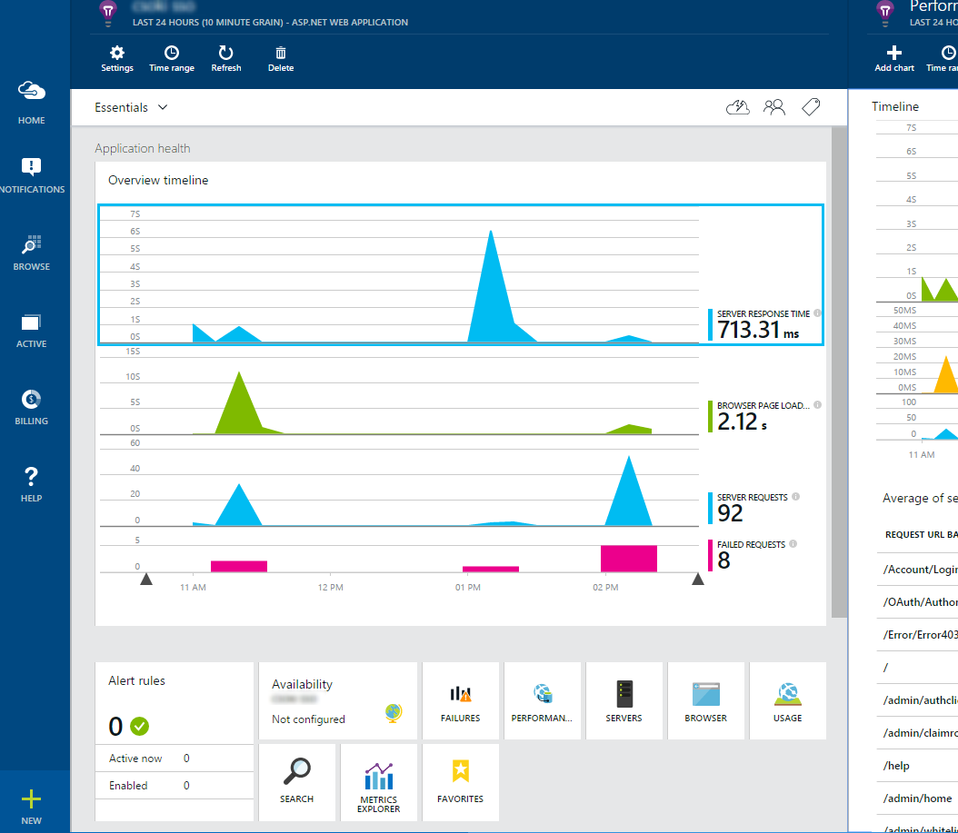
Test
Measure

Slide 28
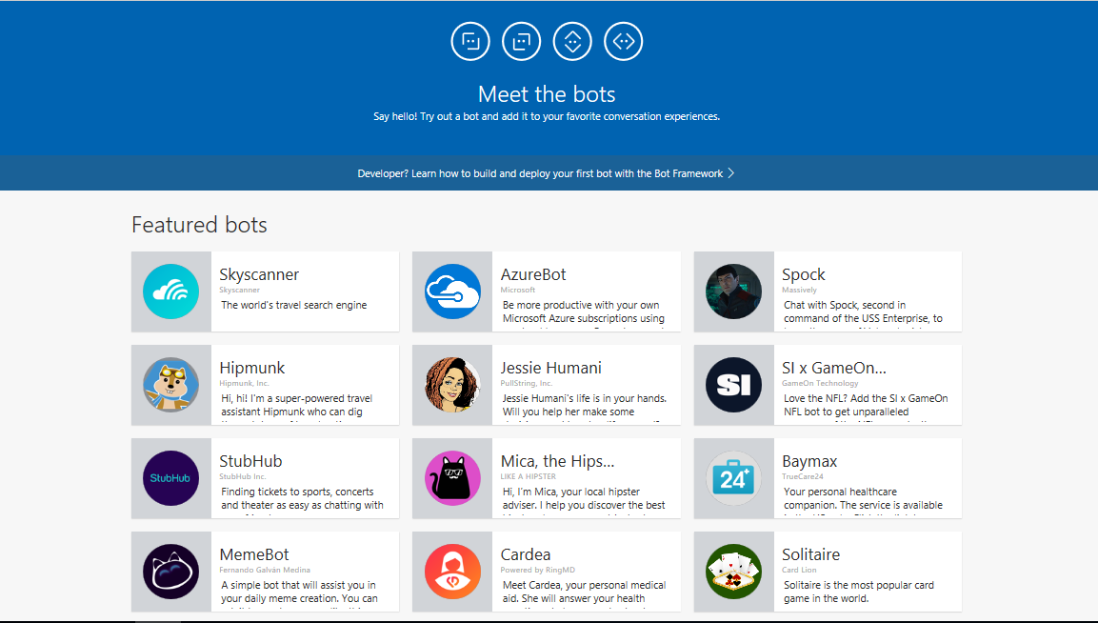
Bot Directory

Slide 29
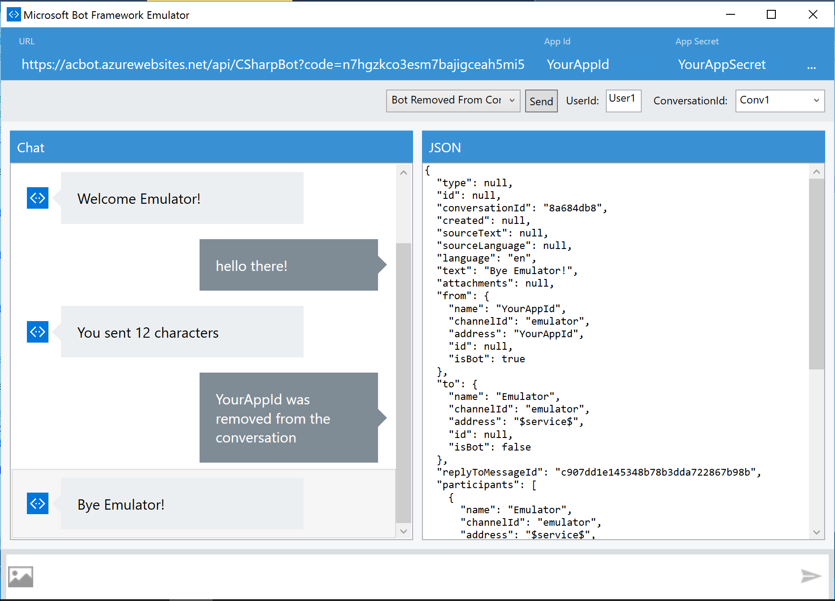
Bot Framework Emulator
Send requests
Receive response
Inspect JSON
Have multiple conversation
Emulate a user

Slide 30
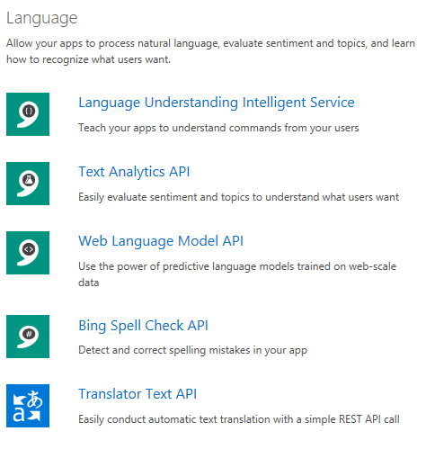
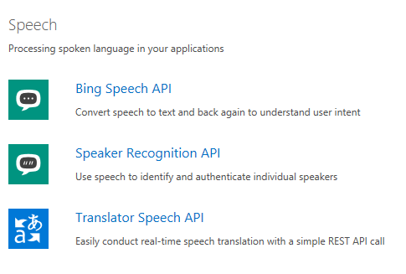
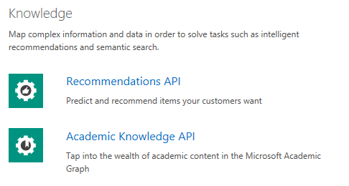
Azure Cognitive Services
Language - Speech - Knowledge – Vision - Search

Slide 31
LUIS.ai
Language Understanding Intelligent Service(LUIS)

Slide 32
Example – Turn on the lights for the kitchen
Utterance
Intent
Entity
Can you please turn on the lights for the kitchen ?
Turn light on
Room = kitchen
Utterance : A plain English sentence
Intent : What is the speaker trying to do?
Entity : What things is the speaker referring to?

Slide 33
Example – Who is the author of Harry Potter?
Utterance
Intent
Entity
Hey, do you know who wrote Harry Potter?
bookName = Harry Potter
Get Book Author
Example – Can you book me a flight from Kathmandu to Pokhara for January 17 for two people?

Slide 34
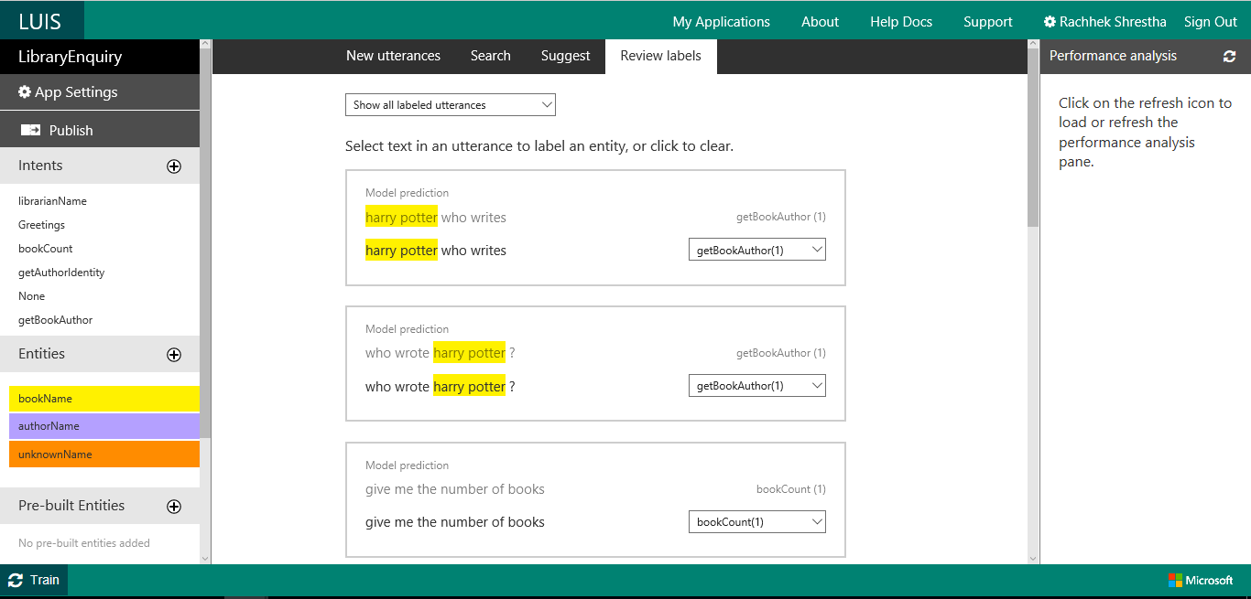
LUIS Dashboard

Slide 35
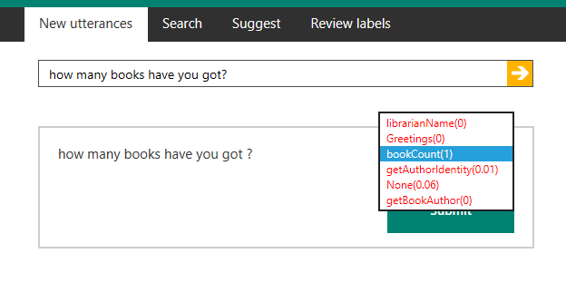
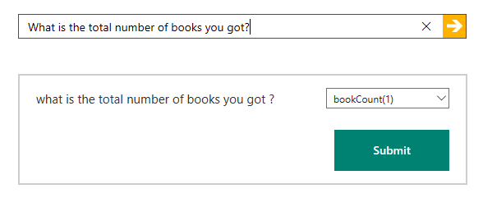
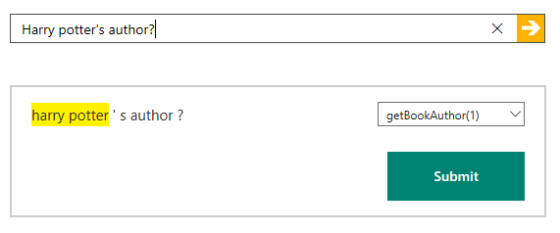

Traning LUIS

Slide 36
How to Begin?

Slide 37
Tools required (for .NET)
Visual studio 2015
Download Bot application template
https://download.botframework.com/bf-v3/builder/vstemplate/Bot%20Application.zip
Copy the zip template to
..\Documents\Visual Studio 2015\Templates\ProjectTemplates\Visual C#
A Microsoft Account (Hotmail, Live, Outlook.com)
“Microsoft.Bot.Builder” for connector to connect to difference channels

Slide 38
Demos and code samples

Slide 39
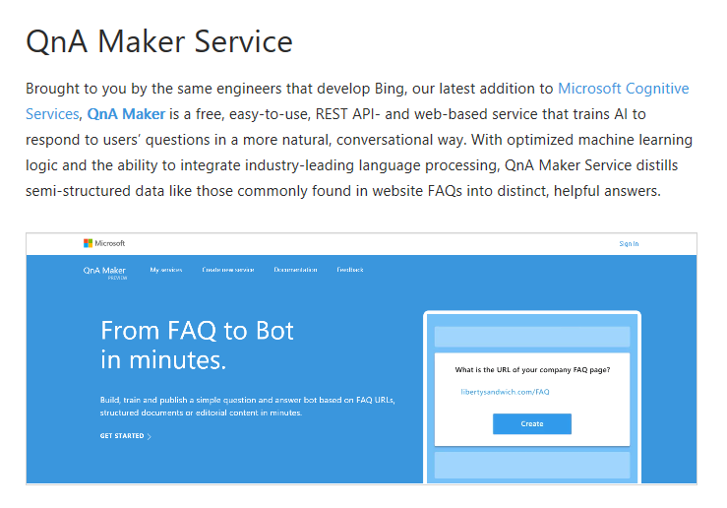
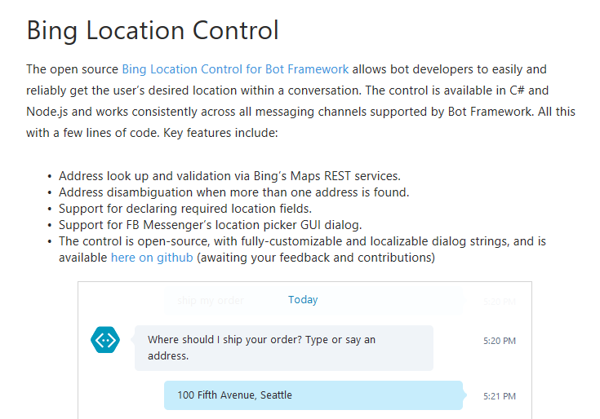
Recent Annoucements
Azure Bot Service

Slide 40
References
https://www.youtube.com/watch?v=TUjnjMKGyDM&t=1592s - MICROSOFT BOT FRAMEWORK
https://chatbotslife.com/chatbot-vs-ai-bot-which-is-here-to-stay-which-to-invest-in-and-why-7ea79a454df3#.r4h7wfewq
https://www.linkedin.com/pulse/what-evolution-all-abot-glenn-miller
http://www.recode.net/2016/4/11/11586022/what-are-bots
https://techcrunch.com/2015/09/29/forget-apps-now-the-bots-take-over/
https://medium.com/making-meya/11-reasons-why-bots-are-the-new-apps-9bb3856d60a7#.b8s4pavxt
https://medium.com/the-layer/why-messaging-bots-won-t-replace-apps-c10413fddc6d#.su5yke9kq
http://www.cio.com/article/3062561/analytics/bots-are-the-new-generation-of-apps.html
https://www.youtube.com/watch?v=SZ3UfwBACIo&t=267s

Slide 41
Thank you

